Slide 1

Free your science:
How preprints can change the way we do science
The EarthArXiv Community

Slide 2
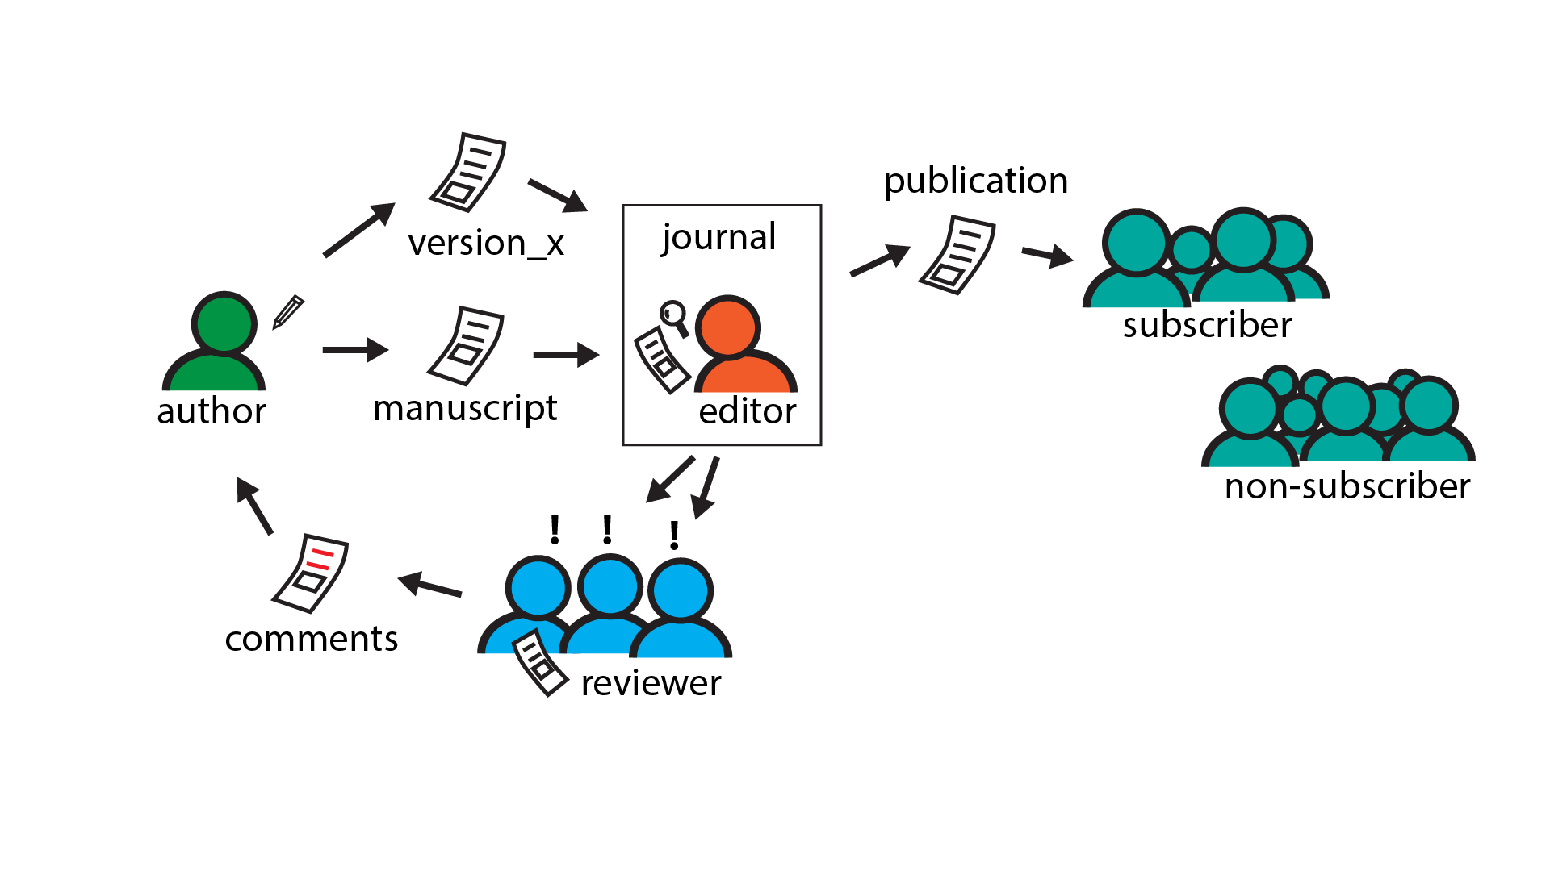
publication pathway(s)

Slide 3
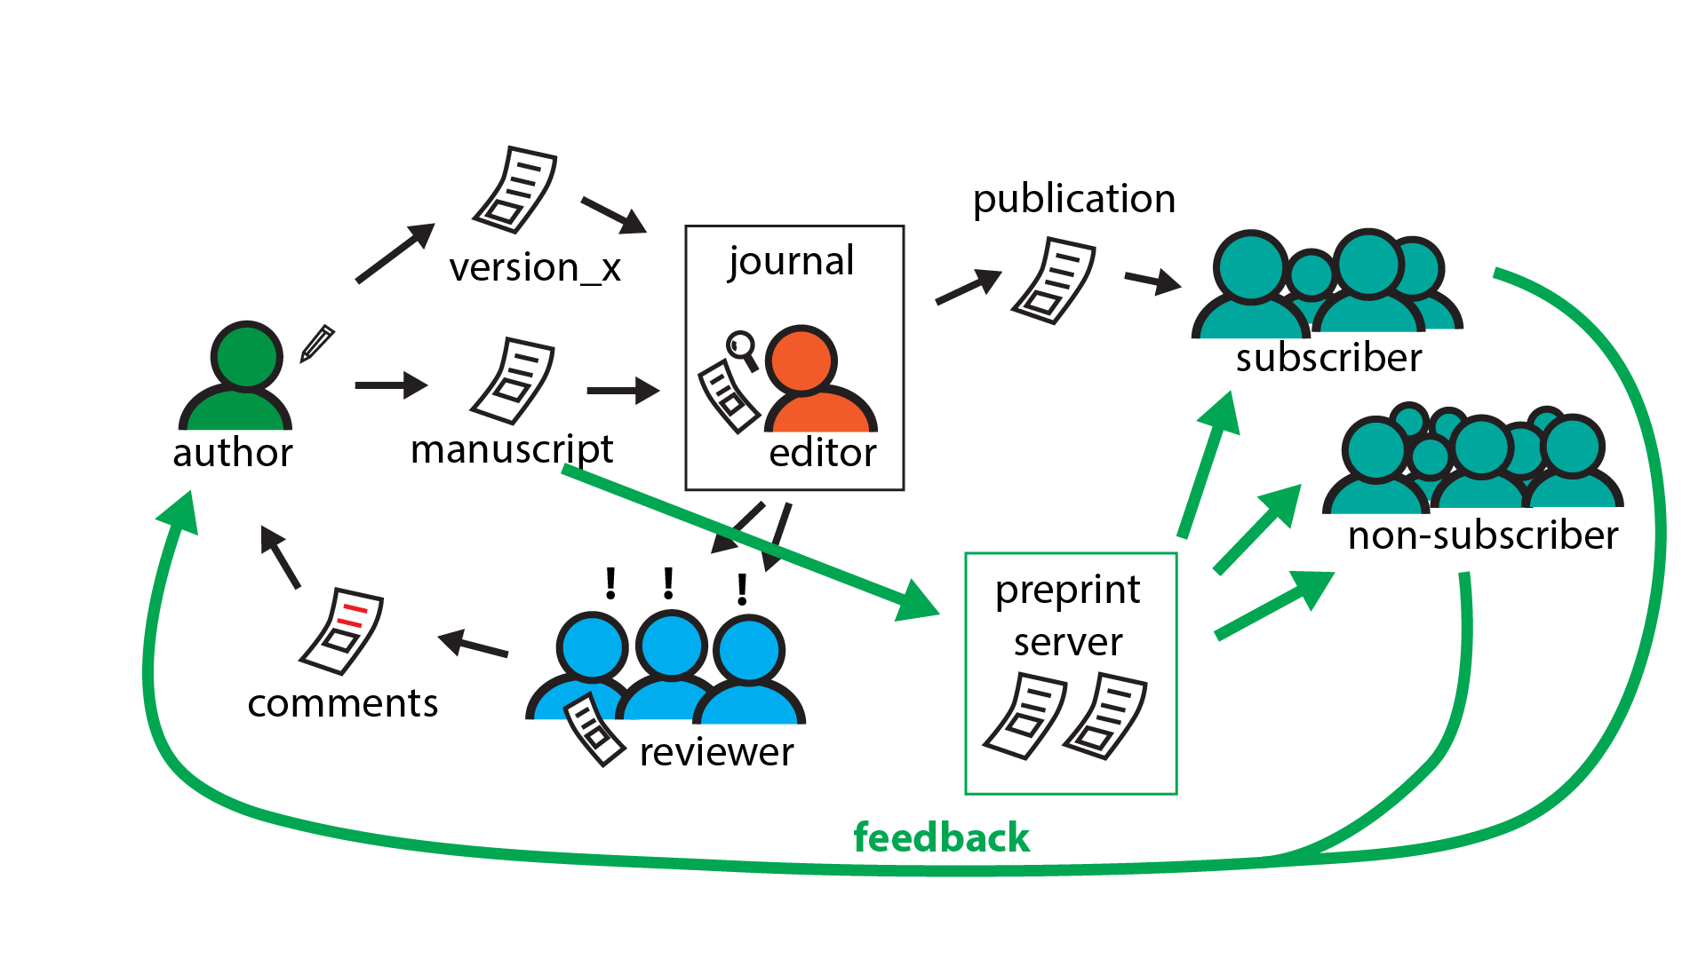
publication pathway(s) with preprints

Slide 4

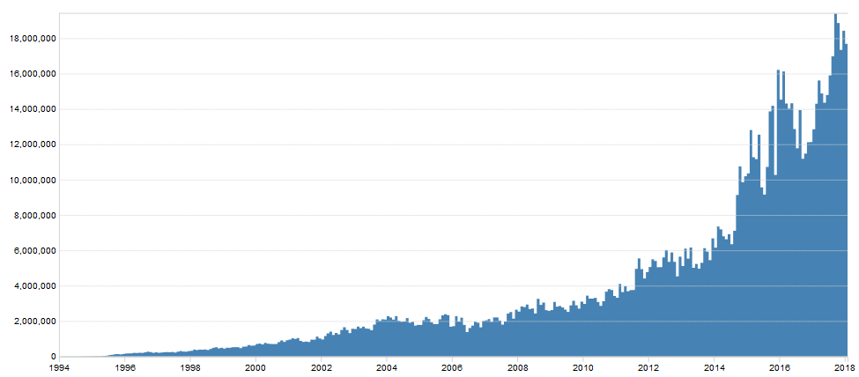
Preprint history –
arXiv.org started in 1991 by Paul Ginsparg for rapid communication of science
(e.g. mathematics, physics, astronomy, computer science, quantitative biology, statistics, and quantitative finance)
today: >1.3 million total submissions;
>1 billion total downloads;
>100,000 publications per year;
c. 18 million downloads per month
18,000,000
10,000,000
Monthly downloads
Year
2000
2010

Slide 5
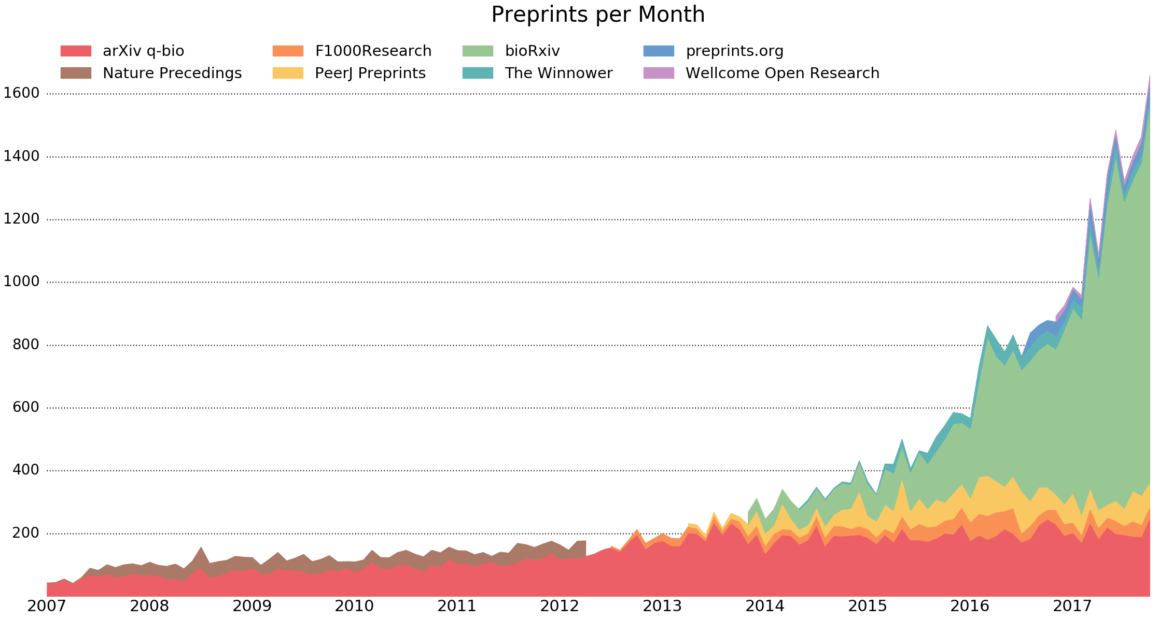
Preprint history
Monthly downloads
Preprints per month
Year
Preprints are not new!
Preprints based on various infrastructure models (e.g. journal vs. community led)

Slide 6
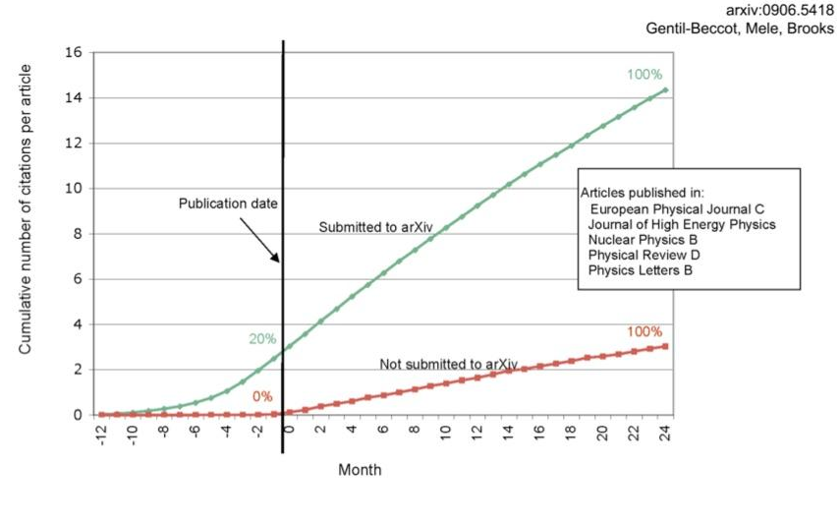
Impact –
There is evidence that submissions to preprint servers such as arXiv.org attract citations earlier and have a higher cumulative number of citations

Slide 7
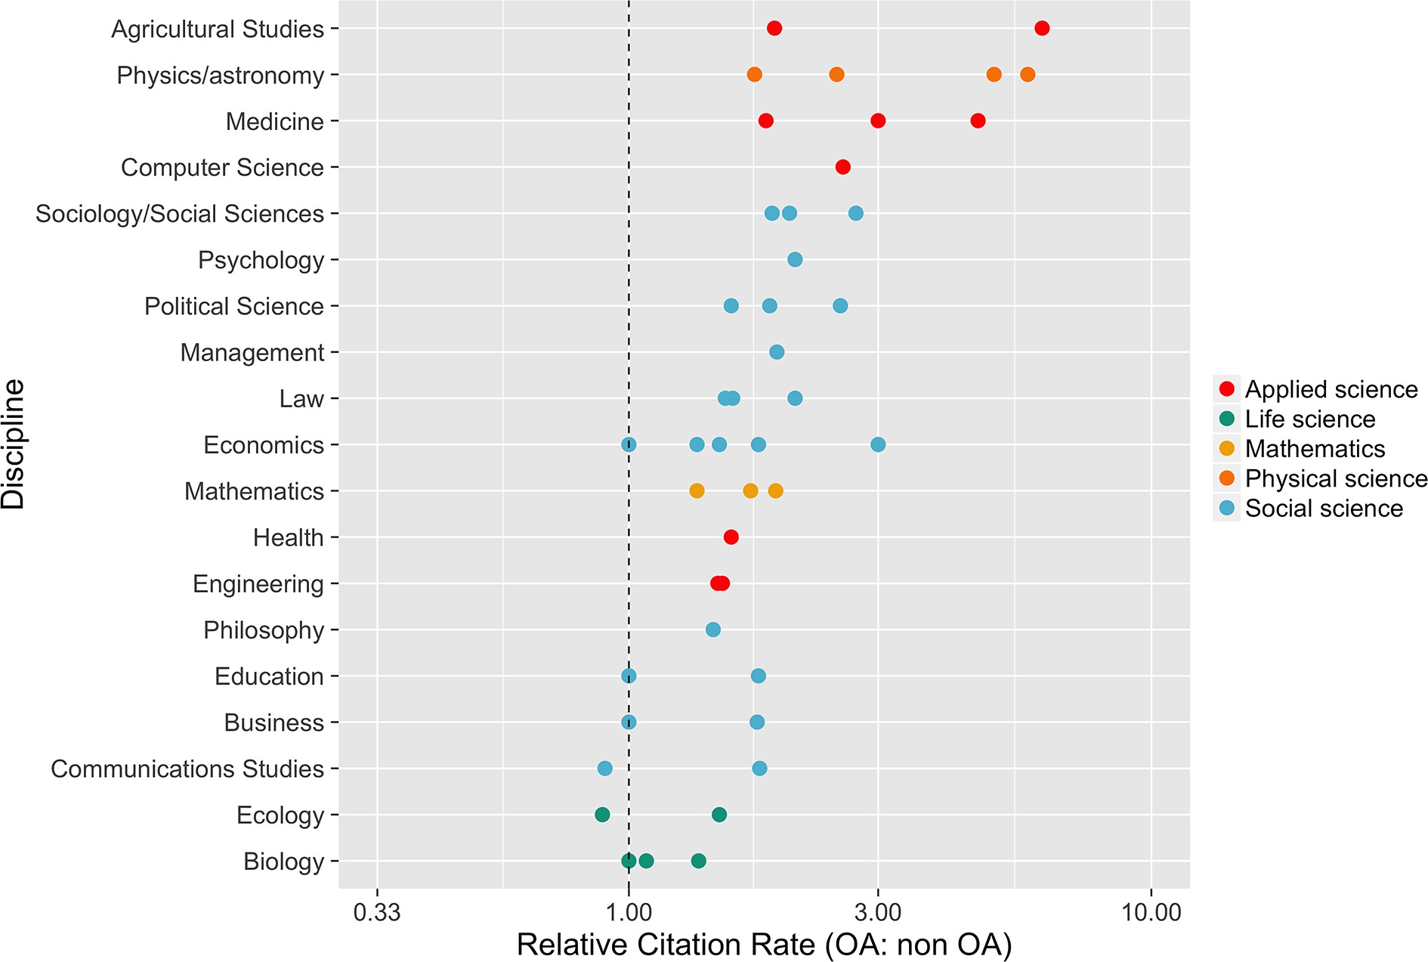
Impact – Open Access
McKiernan et al. (2016)

Slide 8

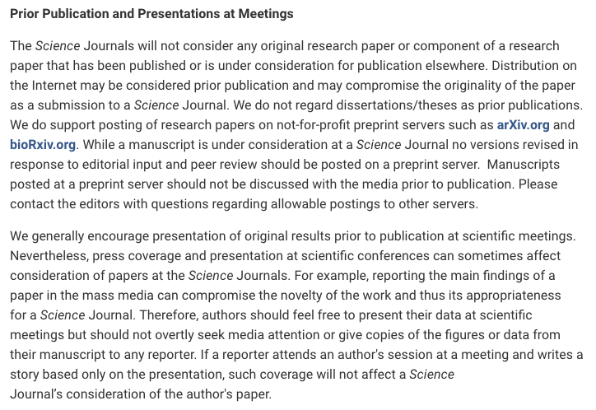
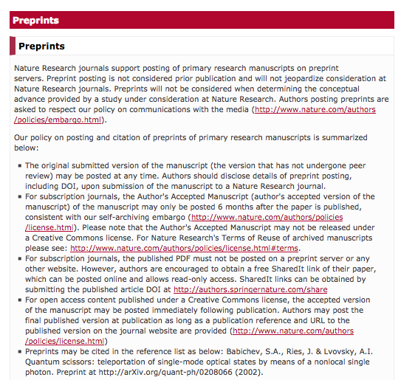


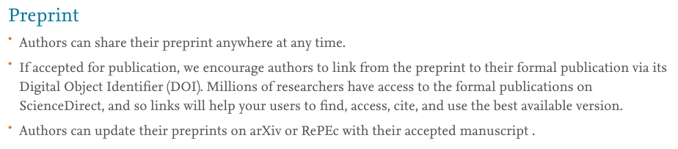
Support - preprints
http://www.sciencemag.org/authors/science-journals-editorial-policies (Friday 6th April 2018)
https://www.nature.com/authors/policies/preprints.html?foxtrotcallback=true (Friday 6th April 2018)
https://www.elsevier.com/about/our-business/policies/sharing (Friday 6th April 2018)

Slide 9
Legal issue - preprints
Demo
http://www.sherpa.ac.uk/romeo

Slide 10
You should consider submitting a preprint if:
You are seeking to communicate your scientific findings without delay
You want everyone to have access to your work
You want feedback on your work from the community
You want to publish larger datasets

Slide 11
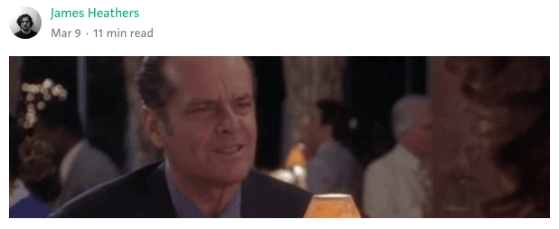
You should consider submitting a preprint if:
You are seeking to communicate your scientific findings without delay
You want everyone to have access to your work
You want feedback on your work from the community
You want to publish larger datasets
https://medium.com/@jamesheathers/why-i-love-pre-prints-9d727eeb22b8
Publishing pre-prints sends a message I want to send.
They say I am willing to talk. They say I want to participate in open culture. Please read my stuff.

Slide 12

Preprints are:
free to submit
fast to publish
open access
established in many natural sciences
EarthArXiv.org
A preprint server for Earth and Planetary sciences

Slide 13



EarthArXiv.org
A preprint server for Earth and Planetary Sciences
online since October 2017
>700 contributions (as of March 2019)
>1600 unique authors
community driven & independent
supported by

Slide 14
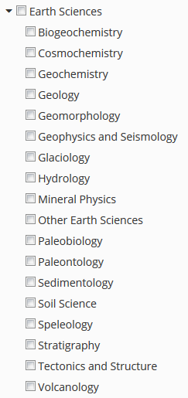
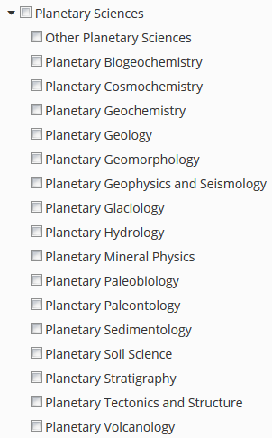
Earth Science
categories
Planetary Science
categories

Slide 15
EarthArXiv.org
Organisation
community driven – everybody can get involved
advisory board
Sara Bosshart, International Water Association, UK
Alodie Bubeck, University of Leicester, UK
Allison Enright, Rutgers - Newark, USA
Jamie Farquharson, Université de Strasbourg, France
Alfonso Fernandez, Universidad de Concepcion, Chile
Stéphane Girardclos, University of Geneva, Switzerland
Friedrich Hawemann, ETH Zurich, Switzerland
Rebecca Williams, University of Hull, UK
Daniel Ibarra, Stanford University, USA
Chris Jackson, Imperial College London, UK
Sabine Lengger, University of Plymouth, UK
Tom Narock, Notre Dame of Maryland University, USA
Andelo Pio Rossi, Jacobs University Bremen, Germany
Divyesh Varade, Indian Institute of Technology Kanpur, India
Chris Waigl, University of Alaska Fairbanks, USA

Slide 16



@eartharxiv
Join us, follow us!
Be part of an OPEN community!

Slide 17
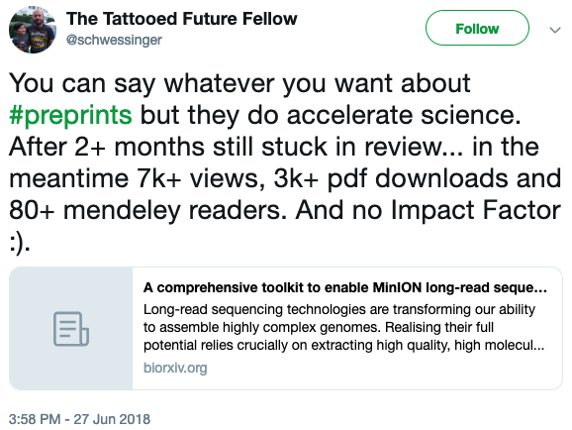
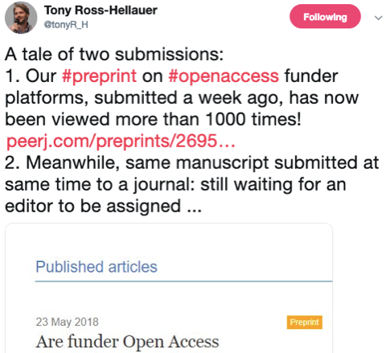
@eartharxiv
Join us, follow us!
Make your work VISIBLE!

Slide 18
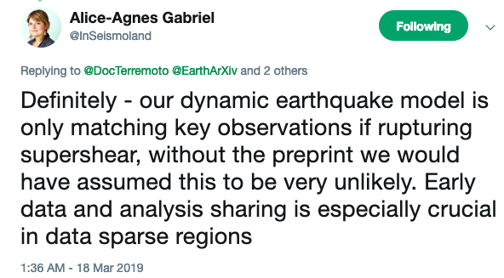
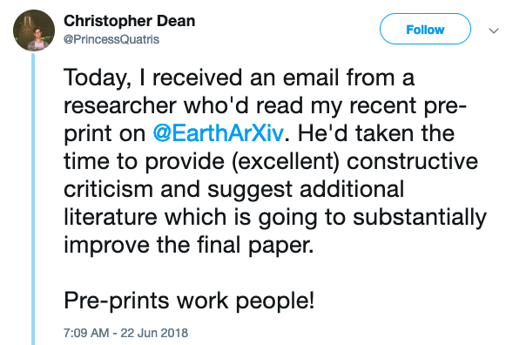
@eartharxiv
Join us, follow us!
Make your work BETTER!
Preprints lead to feedback
& improve your work

Slide 19
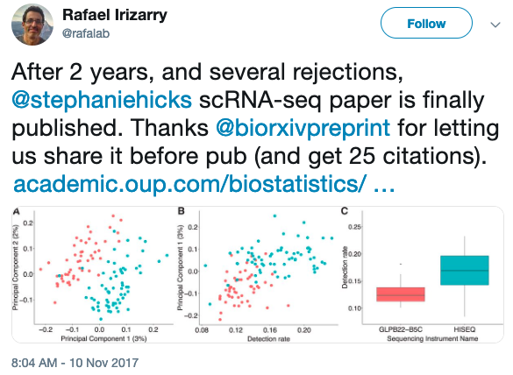
@eartharxiv
Join us, follow us!
Make your work VISIBLE!
Preprints have a
DOI & are citable

Slide 20
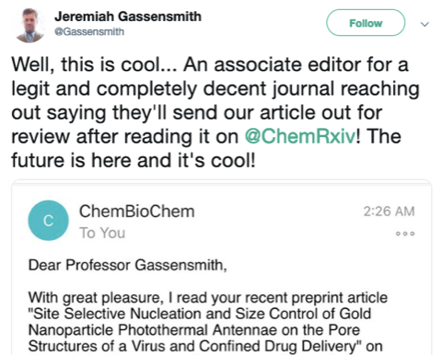
@eartharxiv
Join us, follow us!
Make your work BETTER!
Preprints are turning
around the publishing
system

Slide 21
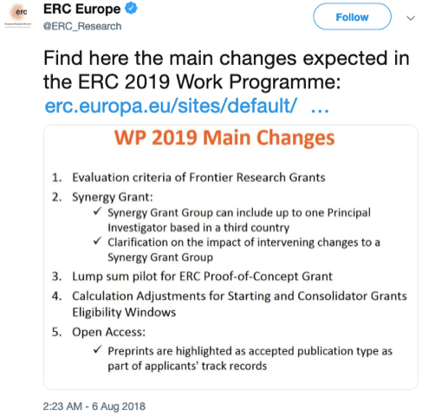
@eartharxiv
Join us, follow us!
Make your work VISIBLE!
Preprints allow you to show your preliminary work
Ideal for grant submissions and career opportunities

Slide 22

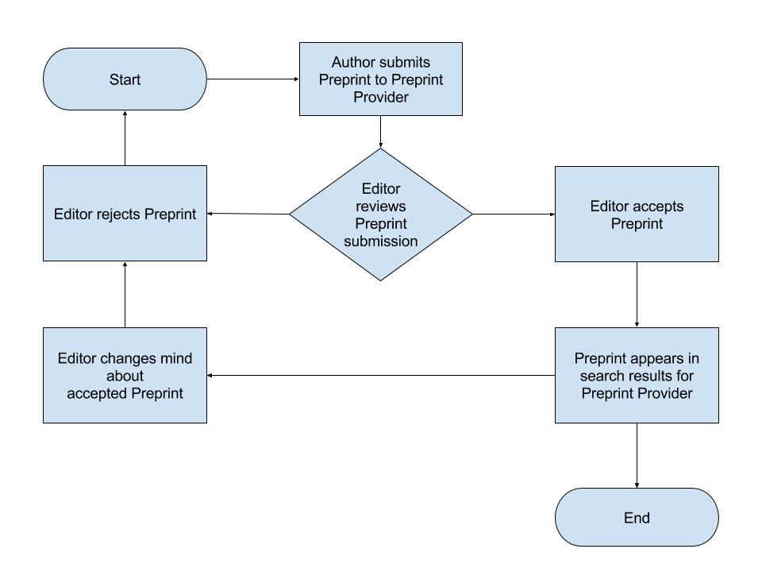
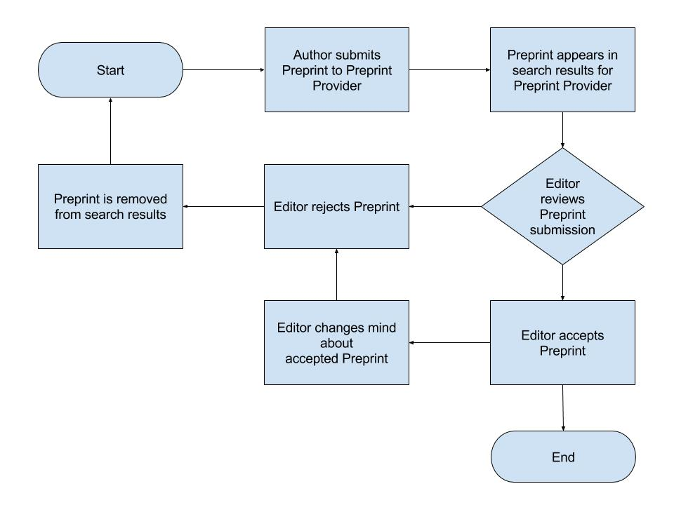
EarthArXiv.org
moderation policy – 2 potential approaches
Pre-Moderation
Post-Moderation
Preprints are not evaluated on scientific content. Preprints are only rejected for being out of scope or missing required metadata

Slide 23
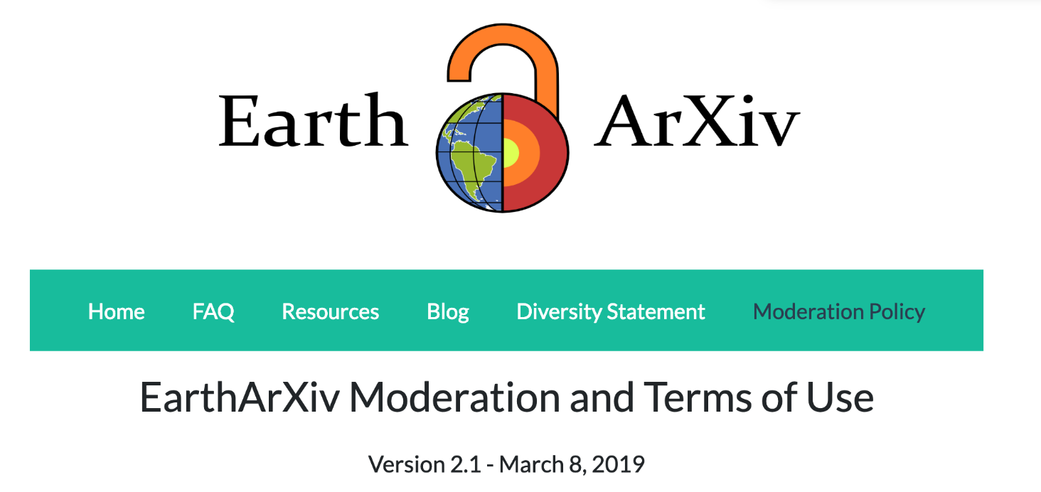
EarthArXiv.org
moderation policy
What does EarthArXiv accept?
What does EarthArXiv not accept?
See our evolving Moderation Policy: https://eartharxiv.github.io/moderation.html

Slide 24
EarthArXiv.org
moderation policy
Publication and hosting of your paper
Upon moderation, EarthArXiv agrees to publish your paper by assigning a DOI
EarthArXiv is not a journal and does not evaluate the scientific quality of a paper. Once a paper passes moderation and is published, it persists on the system indefinitely.
EarthArXiv will provide free online hosting of your paper as long as it is operational
Fraud and Plagiarism
EarthArXiv takes fraud and plagiarism very seriously.
Should the Board deem fraud or plagiarism to have occurred, the paper will be immediately removed from EarthArXiv

Slide 25

COS is a non-profit technology organization based in Charlottesville, Virginia with a mission to "increase the openness, integrity, and reproducibility of scientific research.”.
It was founded in January 2013 by Brian Nosek and Jeffrey Spies, funded mainly by the Laura and John Arnold Foundation and others, after implementation and use of the Open Science Framework
back to previous section

Slide 26

OSF Preprints and the OSF supporting it are public goods infrastructure with open-source code at the COS GitHub repo
10,000+ preprints currently hosted directly on the OSF across 19, co-searchable services
Powered by SHARE (share.osf.io), OSF Preprints aggregates search across local and external preprint services
Currently >2M preprint records available

Slide 27
Connecting the research workflow and archiving activities, changes, outputs with tools to facilitate collaboration, sharing, and ease of access

Slide 28
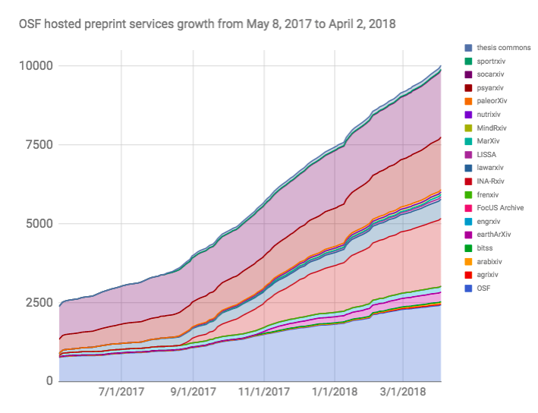
OSF Preprints and the OSF supporting it are public goods infrastructure with open-source code at the COS GitHub repo
10,000+ preprints currently hosted directly on the OSF across 19, co-searchable services
Powered by SHARE (share.osf.io), OSF Preprints aggregates search across local and external preprint services
Currently >2M preprint records available
Submissions hosted
Time

Slide 29
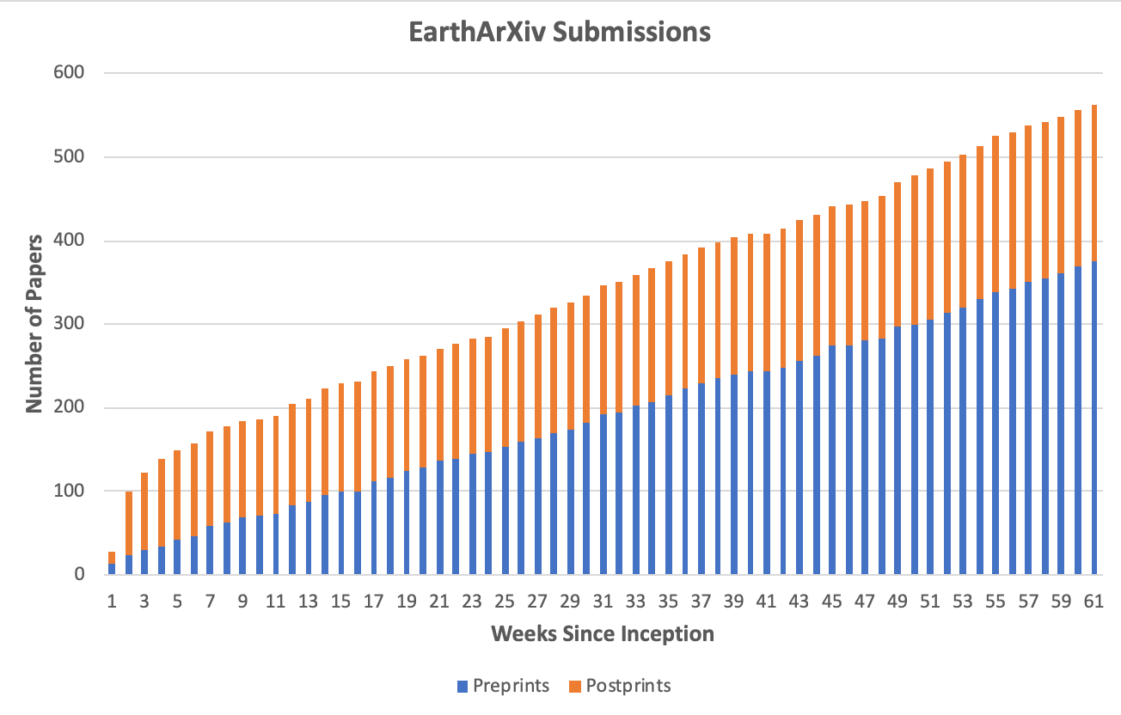

Slide 30
Resources
Get in touch!
Get involved in the new
Advisory Council 2019!
https://eartharxiv.github.io
Resources, including a PICO-
version of this presentation
@eartharxiv
@eartharxiv
www.eartharxiv.org
tnarock@ndm.edu
c.jackson@imperial.ac.uk

Slide 31
Recent development: Plan S by cOAlition S
“By 2020 scientific publications that result from research funded by public grants provided by participating national and European research councils and funding bodies, must be published in compliant Open Access Journals or on compliant Open Access Platforms.”
Members: European Research Council and 15 national organisations
Supported by 28 national and international institutions (and counting)

